Slide 1
CPE 133
Verilog Procedural Blocks
Standard & Non-standard decoders
Experiment 4

Slide 2
Digital Design
It’s not about implementing functions
K-maps to reduce functions
No one really reduces anything any more
Following examples
Mostly there for reference
How to learn Verilog
Read about it, use it, ask questions, repeart

Slide 3
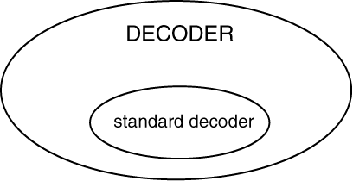
Standard vs. Non-Standard Decoder
Non-standard decoder = generic decoder
Decoders: anything you can define in tabular format (table)
Analogous to LUTs (look-up table) in programming
Standard decoder is specialized form of generic decoder

Slide 4
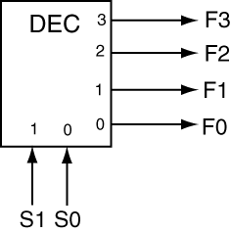
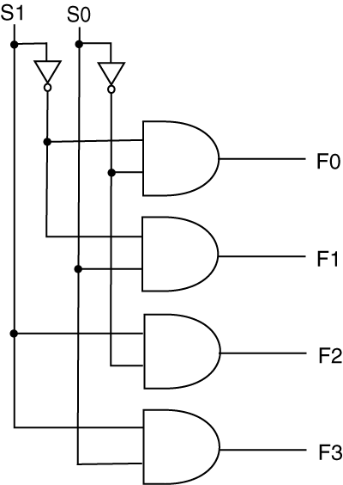
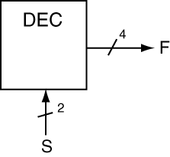
Standard Decoder
Relatively simple circuit

Slide 5
Standard Decoder Overview
Have fixed output
One-hot (or one-cold)
Often referred to as a DMUX?
Has a somewhat specialized purpose
Used to enable one device while disabling many other devices
General Forms: binary relationship
1:2, 2:4, 3:8, 4:16, etc.
Simple to model in Verilog

Slide 6
Generic Decoders
Truth table = LUT (look up table)
Generic decoder: LUT
Everything we’ve done was from a truth table
Could have been implemented as a non-standard decoder
Generic Decoders: smart functions implementation
No reduction necessary!
Great for multiple input/multiple output modules
An initial step in any digital design is to think of a way you can implement your circuit using a LUT
Typically: implement logic using decoder

Slide 7
RCA Foundation Module
Generic Digital Circuit
Standard Decoder Foundation Module Notation

Slide 8
Generic Decoder Foundation Module
Generic Digital Circuit
Generic Decoder Foundation Module Notation

Slide 9
Verilog: Behavioral Modeling
Continuous assignment statements
dataflow? (low level descriptions)
Example:
assign F = (A & ~B) | (C & ~D);
always blocks
One type of procedural block
Allows for modeling of circuits using a description rather than low-level logic

Slide 10
always block Overview
Contains two types of items
procedural assignment statements
Example: A = B;
procedural programming statements
if-else statements
case statements
All assignments must be to variables
We only use reg types variable
Example: A = B; //- A must be reg-type

Slide 11
The always block
always @(sensitivity_list)
begin : block_name
statements
end
Sensitivity list
List of every input to block
Statements
Procedural programming
Procedural assignment

Slide 12
Variable Assignment
All assignments must be to reg-types
//---------------------------
//- reg declaration when
//- variable is part
//- of module interface
//----------------------------
module var_example_1(A,B,C,F);
//- external interface
input A, B, C;
output reg F;
//----------------------------
//- reg declaration when
//- variable is an
//- internal signal
//---------------------------
module var_example_2(A,B,C,F);
//- external interface
input A, B, C;
output F;
reg my_var;

Slide 13
The if: (Procedural Programming Statements)
All assignments must be to reg-types
//--------------------------
//- not for combinatorial
//- circuits
//--------------------------
if (expression)
statement
//---------------------------
//- not for combinatorial
//- circuits
//---------------------------
if (expression)
begin
statement(s)
end

Slide 14
The if-else: (Procedural Programming Statements)
All assignments must be to reg-types
if (expression)
statement
else //- catch-all
statement
if (expression)
begin
statement(s)
end
else //- catch-all
begin
statement(s)
end

Slide 15
The case: (Procedural Programming Statements)
All assignments must be to reg-types
Special form of if-else statement
case (expression)
case_item : statement;
case_item : statement;
default : statement; //- catchall
endcase

Slide 16
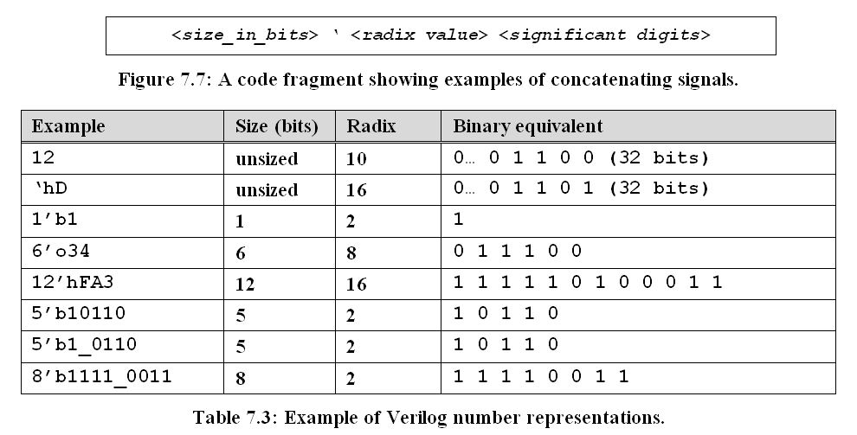
Representing Integers

Slide 17
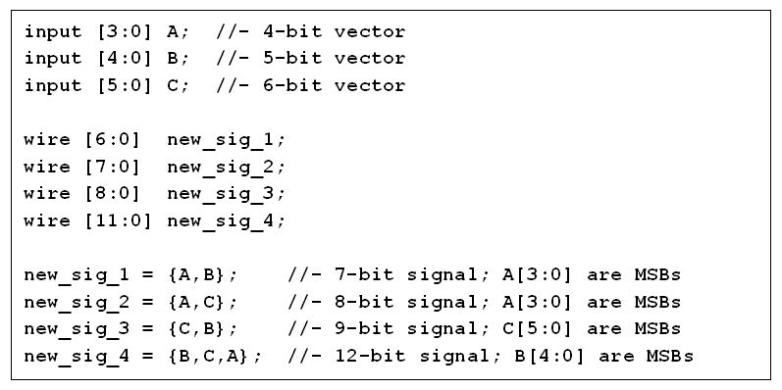
Concatenating Signals
sd

Slide 18
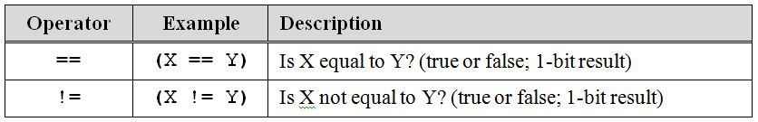
Equality Operators
If “expression” arguments

Slide 19
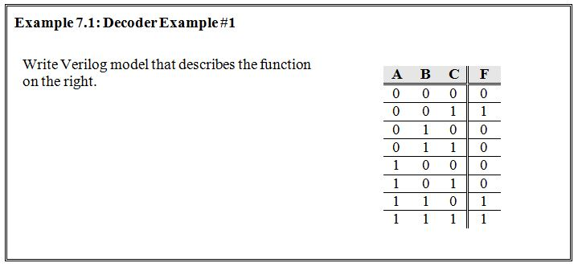
Example 1
What you’ve been doing

Slide 20
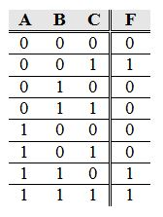
Solution
module dcdr_generic_ex1(A, B, C, F);
input A, B, C;
output reg F;
//- declare bundle
wire [2:0] ABC;
//- create bundled signal with concatenation
assign ABC = {A,B,C};
always @(ABC)
begin
if (ABC == 3'b001) F = 1'b1;
else if (ABC == 3'b110) F = 1'b1;
else if (ABC == 3'b111) F = 1'b1;
else F = 1'b0; //- catch-all
end
endmodule

Slide 21
Solution
module dcdr_generic_ex1b(A, B, C, F);
input A, B, C;
output reg F;
//- declare bundle
wire [2:0] ABC;
//- create bundled signal with concatenation
assign ABC = {A,B,C};
always @(ABC)
begin
case (ABC)
3'b001 : F = 1'b1;
3'b110 : F = 1'b1;
3'b111 : F = 1'b1;
default : F = 1'b0;
endcase
end
endmodule

Slide 22
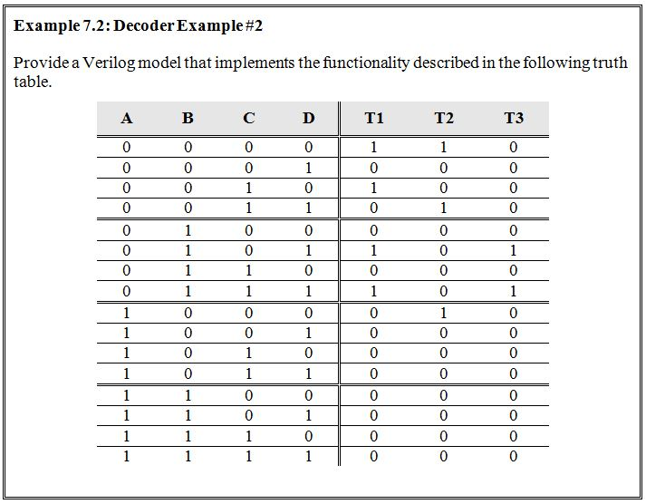
Example 2

Slide 23
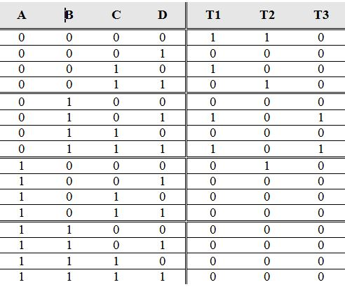
Solution
module dcdr_ex2a(ABCD, T123);
input [3:0] ABCD;
output reg [2:0] T123;
always @(ABCD)
begin
if (ABCD == 0) T123 = 3'b110;
else if (ABCD == 1) T123 = 3'b000;
else if (ABCD == 2) T123 = 3'b100;
else if (ABCD == 3) T123 = 3'b010;
else if (ABCD == 4) T123 = 3'b000;
else if (ABCD == 5) T123 = 3'b101;
else if (ABCD == 6) T123 = 3'b000;
else if (ABCD == 7) T123 = 3'b101;
else if (ABCD == 8) T123 = 3'b010;
else T123 = 3'b000;
end
endmodule

Slide 24
Solution
module dcdr_ex2b(ABCD, T123);
input [3:0] ABCD;
output reg [2:0] T123;
always @(ABCD)
begin
case (ABCD)
0 : T123 = 3'b110;
1 : T123 = 3'b000;
2 : T123 = 3'b100;
3 : T123 = 3'b010;
4 : T123 = 3'b000;
5 : T123 = 3'b101;
6 : T123 = 3'b000;
7 : T123 = 3'b101;
8 : T123 = 3'b010;
default : T123 = 3'b000;
endcase
end
endmodule

Slide 25
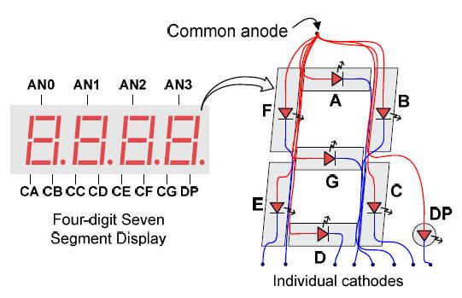
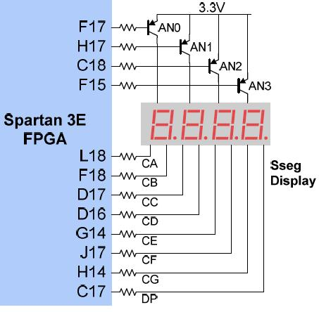
Common Anode Configuration
Each segment required at least two signals to make it light up

Slide 26

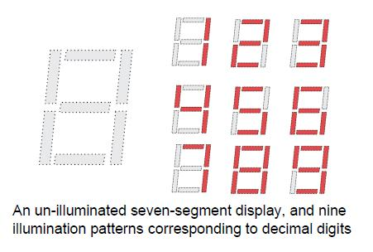
Seven-Segment Displays

Slide 27
Exp #4: BCD-to-7Segment Decoder
Four switches provide BCD
Output result on 7-segment display device
Anodes & Cathodes are active low (zero actuates)
9 signals required to actuate a single 7-segment display
Eight signals for the segments & DP (cathodes)
One signal to enable the display (anodes)
Work from the examples in book or PPTs
There are several approaches to modeling this device
Implement this device as LUT
Visually test circuit on the development board

